Slide 1
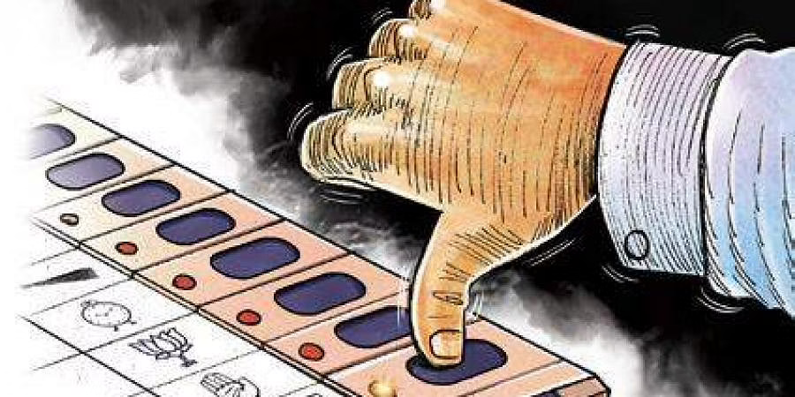
Election Management
“Voting is the most powerful non-violent tool we have in a democratic society, and we must use it.” - John Lewis

Slide 2
Brief Overview
Citizen Registration
Aadhar Card generation
Voter Registration
Candidate Addition
Release of Candidates List and Parties Contesting
Vote Casting
Result declaration
Notes:
Uml image

Slide 3
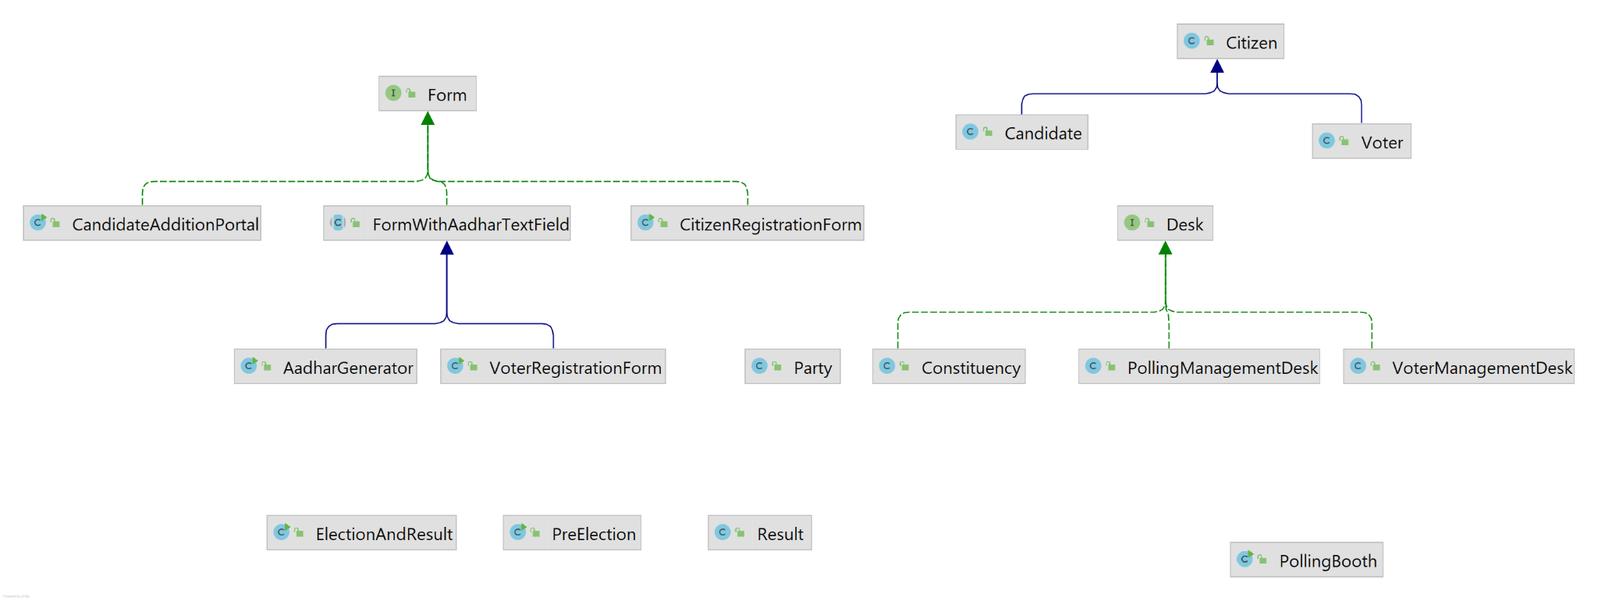
Project Structure

Slide 4
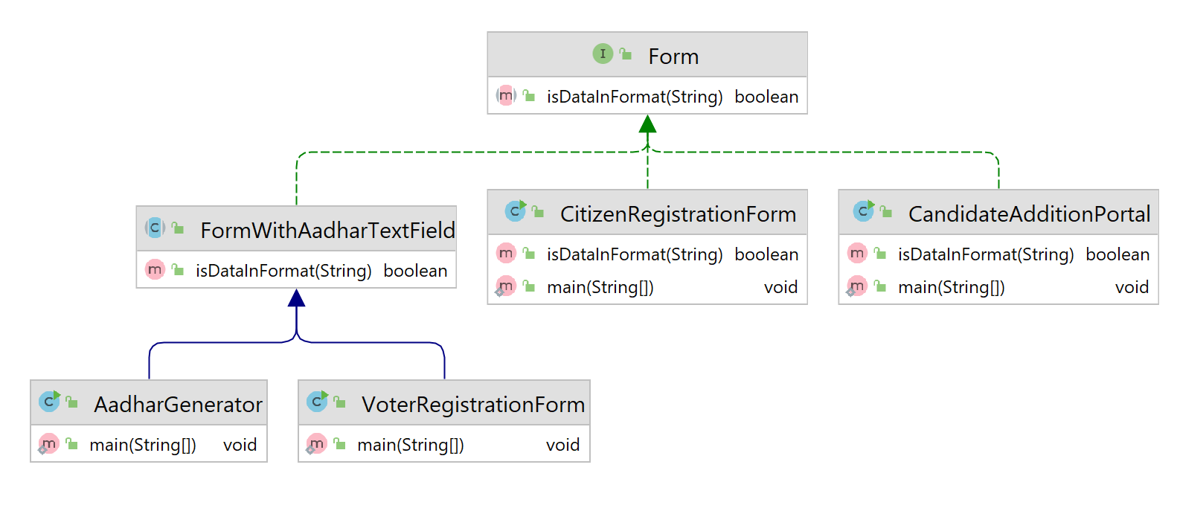
Forms Class Structure

Slide 5
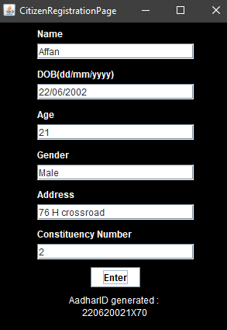
Citizen Registration
The form checks format using isDataInFormat()
Calls method registerIndividual() from Constituency class

Slide 6
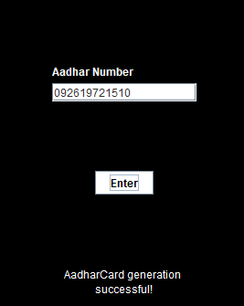
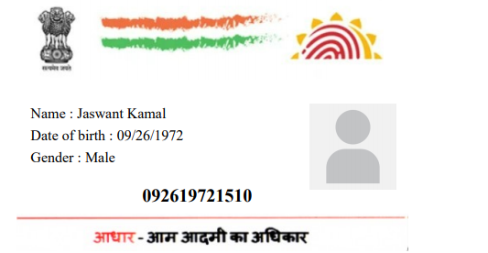
Aadhar Generator

Slide 7
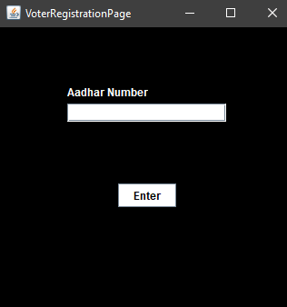
VoterRegistrationForm
-The form checks format using isDataInFormat()
-Adds the voter into the voterData
-Calls method registerIndiviidual() from VoterManagementDesk
class

Slide 8
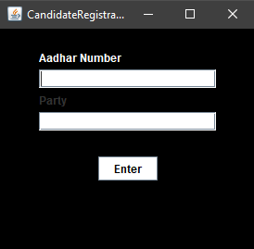
Candidate
-The form check format using isDataInFormat()
-Calls register Individual() of Polling Management Desk class

Slide 9
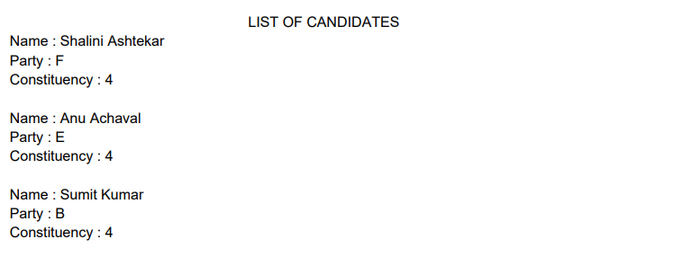
Candidate List
Candidate Info can be generated by the Admin for the benefit of the public.

Slide 10

Polling Booth
The process of voting is implemented in the Polling Booth class
A voter’s credentials are validated and the voter is allowed to vote
An automate method is implemented to register votes automatically to show Proof of Concept

Slide 11
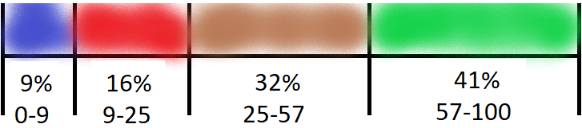
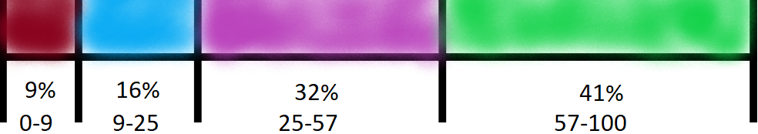
Automation Method
9.2, 8.6, 7.2, 6.4
10(minus)Popularity Score
0.8, 1.4, 2.8, 3.6
3.6, 2.8, 1.4, 0.8 (total=8.6)
0.41, 0.32, 0.16, 0.09
A random number is generated

Slide 12

Result
Total Result of State
Candidate details
Result of each constituency
Voter Details

Slide 13

Result
( Brief working detail of Result class)
Each format of Result is implemented as method in Class.
Polling Booth object is passed while creating the Result Object
Result of Each constituency is stored in polling booth object.
The ResultData of each constituency is collected from polling management desk and voter management desk objects of each constituency which is accessed through polling booth.
The collected result data is displayed in PDF.

Slide 14
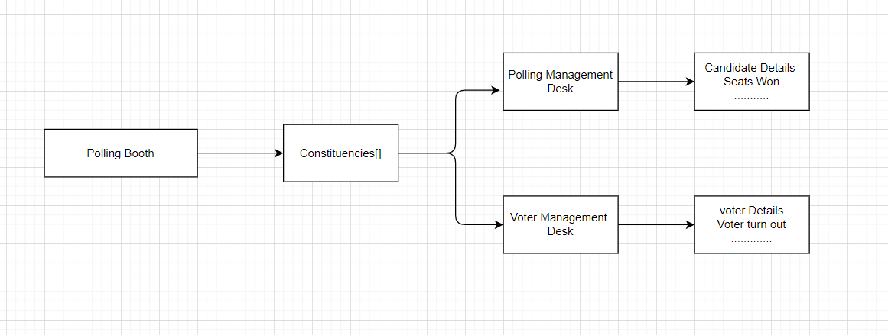
Result Dataflow

Slide 15
Displaying Result

Slide 16
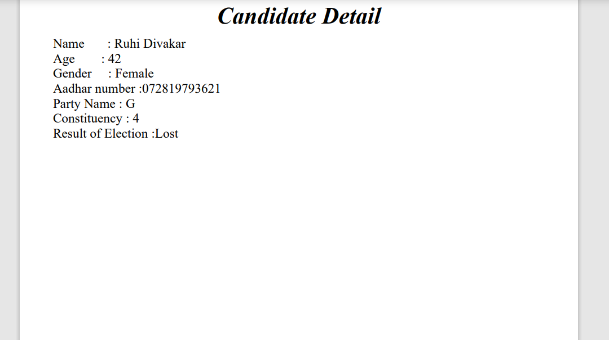
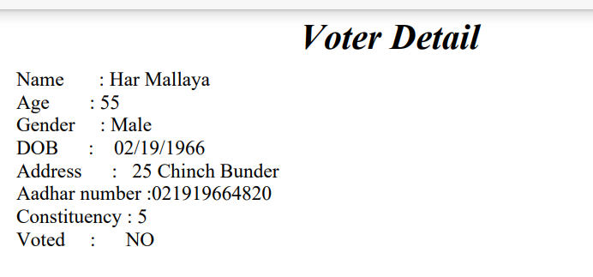

Slide 17
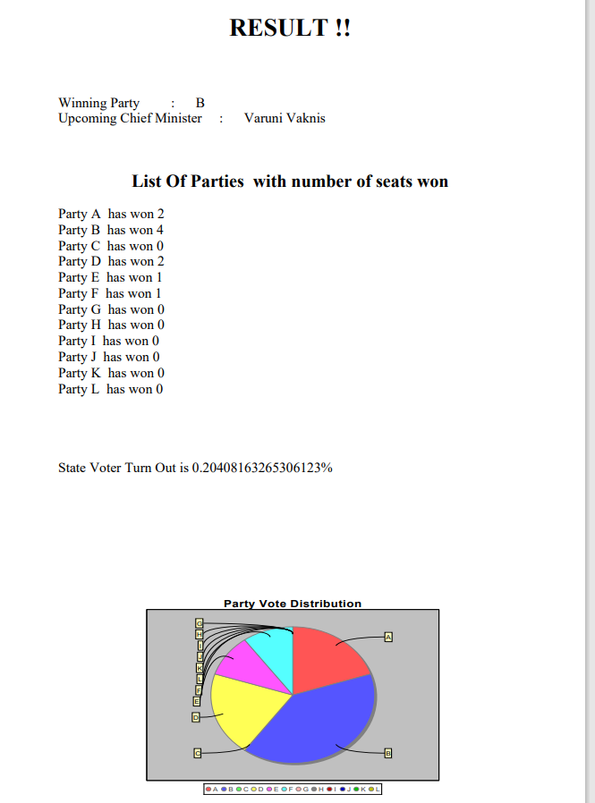

Slide 18
Thank You

